Slide 1
Your Experts in CHNOS & TOC
MASTPAWG
Feruary 2023

Slide 2
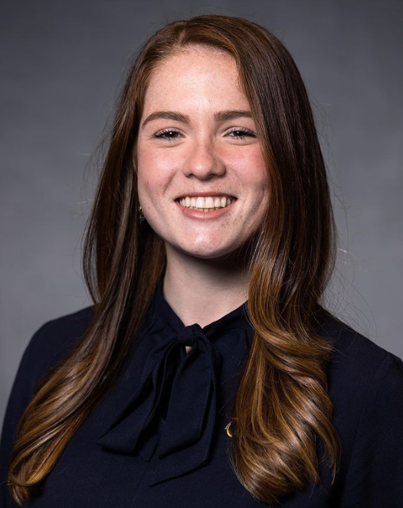
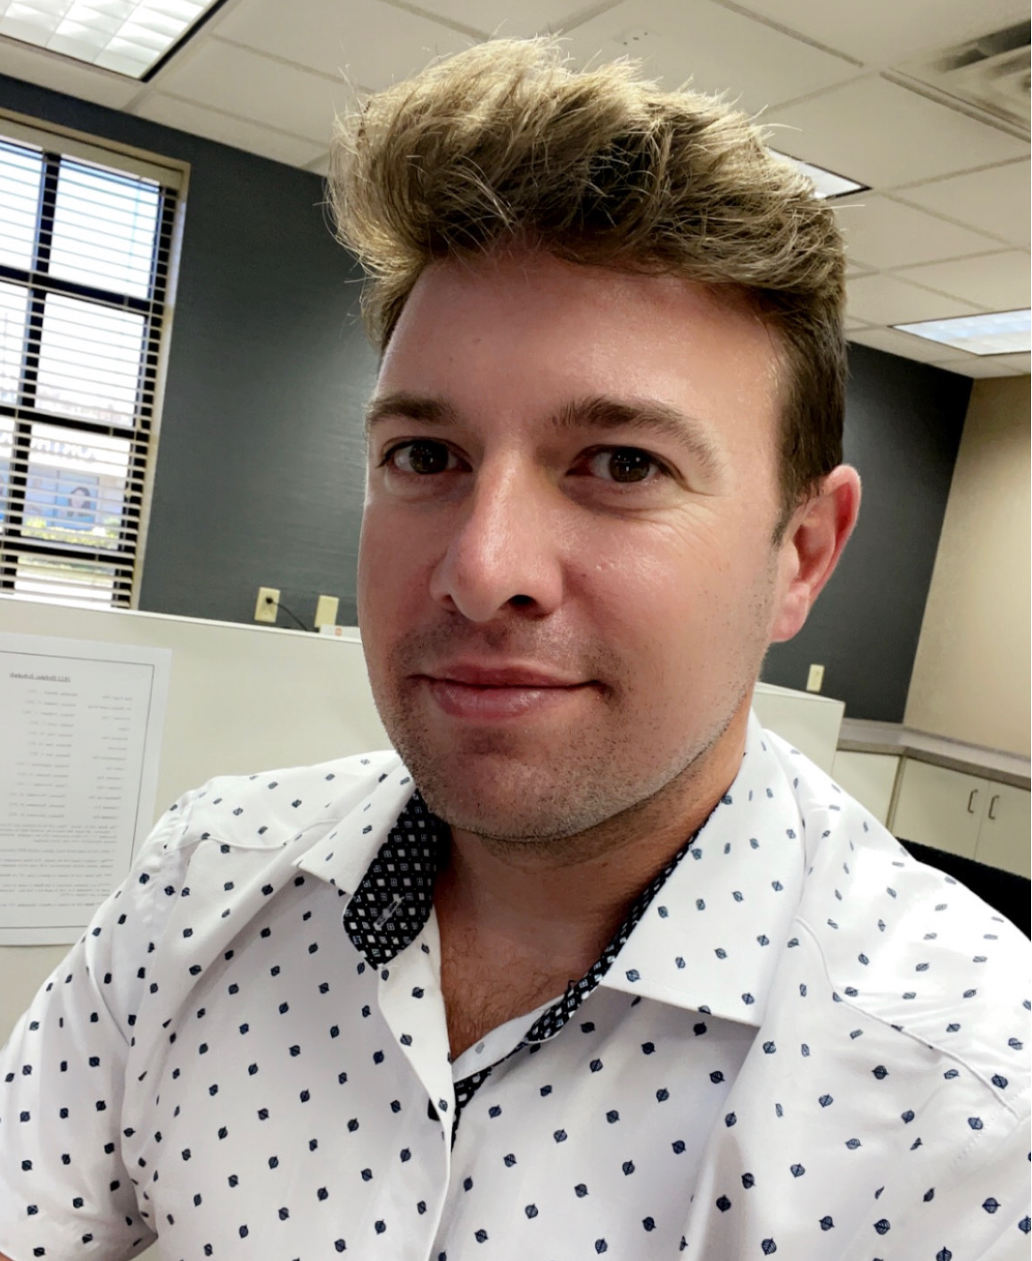
Meet the Team!
Valerie Conforti
Chase Migliore
Northeast Sales (Maine to Virginia)
3 years in Application Lab
Southeast Sales (North Carolina to Florida)
5 years in Crude Oil and Water Chemistry

Slide 3
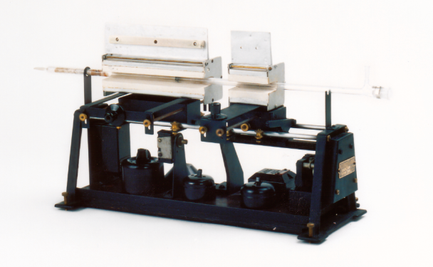
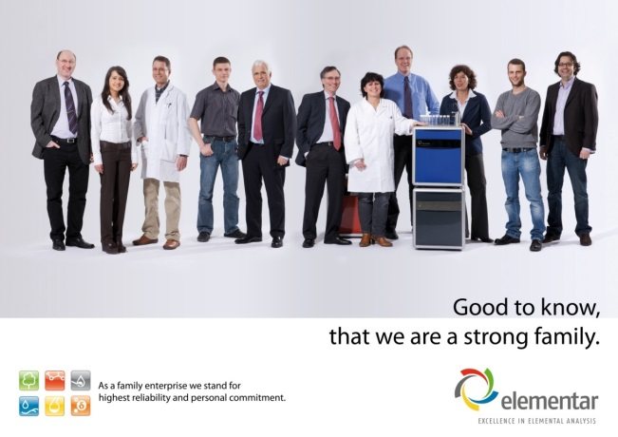
Elementar – Tradition means trust
The inventor of the elemental analyser!
  The first automated elemental analyser was developed in Hanau, our predecessor Heraeus invented the elemental analyser!
We are a strong family
  Family-owned enterprise without the uncertainties of a sudden change in ownership, organizational structures and management.
Heraeus historic elemental analyzer, type "CH Analysator", construction year 1932. The worldwide first elemental analyzer with electrical furnaces.
Notes:
The first automated elemental analyser was developed in Hanau, our predecessor Heraeus invented the elemental analyser!
Family owned enterprise without the uncertainties of a sudden change in ownership, organisational structures, management and staff.

Slide 4
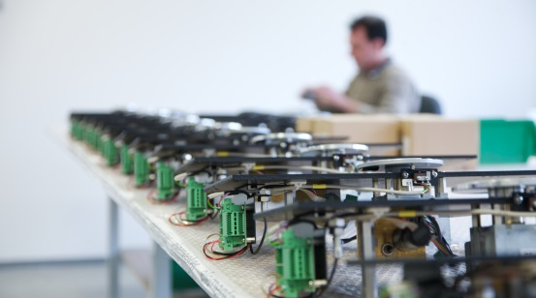
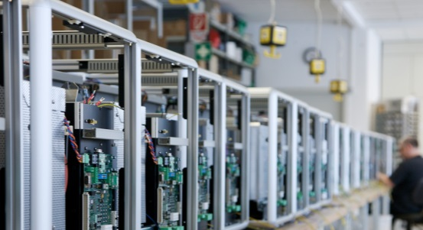
Elementar – Tradition means trust
Quality made in Germany
  All instruments are manufactured in our headquarter in Hanau - quality made in Germany by ELEMENTAR. This ensures highest quality and reliability for the users. Competitors often just sell their label while the production is located somewhere else.
100 % dedicated to elemental analysis
  Due to our 100 % dedication to combustion type elemental analyzers we are able to provide a large variety of instruments in this segment. The customer has the choice to select according to his specific needs in performance and price.
Notes:
All instruments are manufactured in our headquarter in Hanau - quality made in Germany by ELEMENTAR. This ensures highest quality and reliability for the users. Competitors often just sell their label while the production is located somewhere else.
Due to our 100 % dedication to combustion type elemental analyzers we are able to provide a large variety of instruments in this segment. The customer has the choice to select according to his specific needs in performance and price.

Slide 5
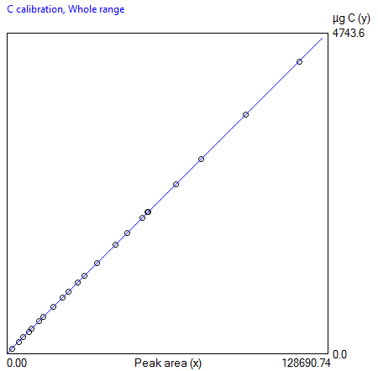
Elementar – technological leadership
Longterm stability and reliability of the calibration
  Stability of the calibration is in the range of several months up to years. The straightforward and robust basic concept make the ELEMENTAR analysers real working horses in the laboratory routine.
Blank-free
  The blank free sample transfer using the patented ELEMENTAR ball valve eliminates all interferences from ambient air from the analysis results and guarantees highest accuracy.
Notes:
Stability of the calibration is in the range of several months up to years. Reliable automatic sample feeding in combination with the straightforward and robust basic concept make the ELEMENTAR analysers real working horses in the laboratory routine.
The blank free sample transfer using the patented ELEMENTAR ball valve eliminates all interferences from ambient air from the analysis results and guarantees highest accuracy.

Slide 6
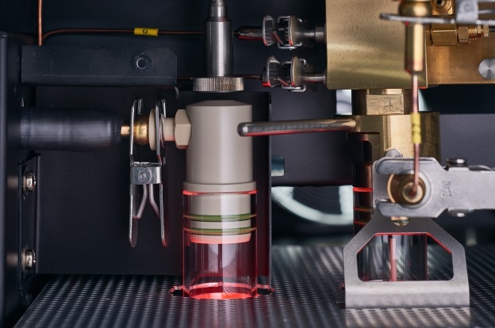
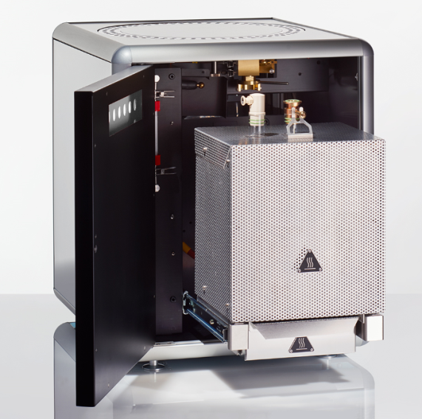
Slide-out furnace and clamp connections
Analysis of all combustion gases
  All of the sample gas produced from combustion or pyrolysis is directed to a single thermal conductivity detector (TCD) without "gas splitting". This ensures quantitative and matrix-independent determination of element concentrations even in slowly digesting or difficult to digest substances.
Easy maintenance
  Easy-to-use clamp connections provide reliable sealing and at the same time make maintenance easy and straightforward. The slide-out furnaces make exchange of reagents a quick and easy task.
Notes:
All of the sample gas produced from combustion or pyrolysis is directed to a single thermal conductivity detector (TCD) without "gas splitting". This ensures quantitative and matrix-independent determination of element concentrations even in slowly digesting or difficult to digest substances.
Easy-to-use clamp connections provide reliable sealing and at the same time make maintenance easy and straightforward. The slide-out furnaces make exchange of reagents a quick and easy task.

Slide 7
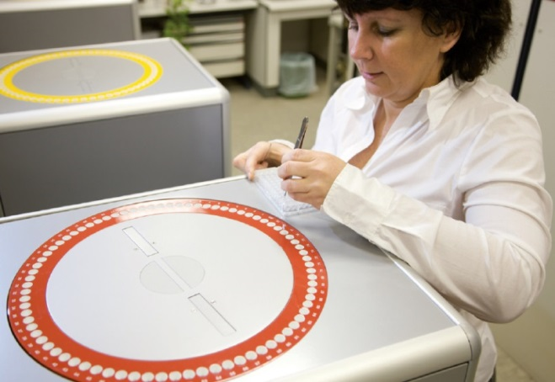
Elementar – Tradition means trust
Long-term orientation
  ELEMENTAR is long term oriented. Spare parts are provided for a minmum of 10 years – also after production stop of an instrument – but also older instruments continue to get technical support. Some of them are in operation for 30 years and more.
Customer focused
  Our inside, sales and service teams are dedicated to providing creative and personalized solutions for you
Notes:
Since ELEMENTAR emerged from the Heraeus organisation in 1990, the group management has not changed. The fluctuation of staff is on an absolute minimum.
ELEMENTAR is long term oriented. Spare parts are provided for a minmum of 10 years – also after production stop of an instrument – but also older instruments continue to get technical support. Some of them are in operation for 30 years and more.

Slide 8
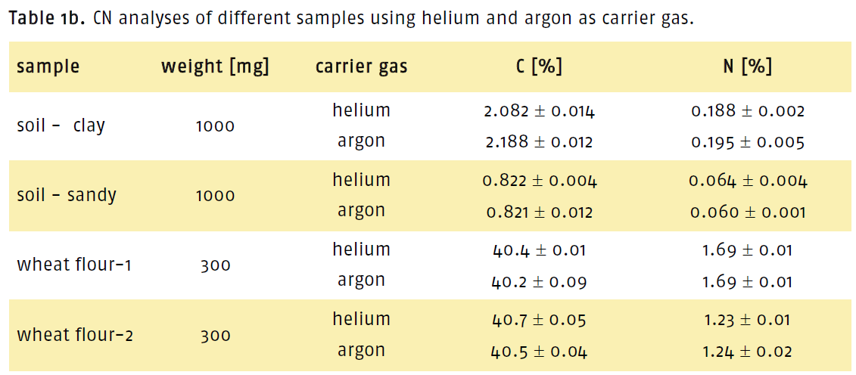
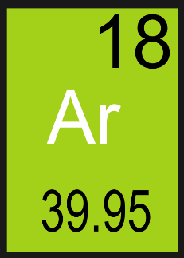
Hot Topics: Argon as Carrier Gas
Argon instead of Helium as a carrier gas to further reduce cost-per-sample
No time-consuming retrofit
Use of Argon has been scientifically proven for the analysis of soils
Notes:
Helium shortages becoming more common

Slide 9
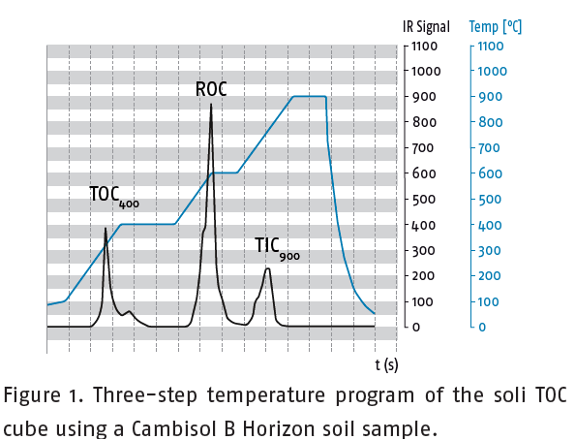
Hot Topics: TOC methods, solids
External Acidification
Low Temperature/Ramping
In agreement with the international standard ISO 10694
Damaging to instrumentation
Time consuming sample prep
More robust consumables and parts available for this
Easy-switch solids module on TOC instruments
Organic carbon combusts from 450-650˚C
No prior acidification
All ash is removed with TIC remaining, or further ramping
Notes:
TOC mode kit: more robust gripper arm, Cerium Dioxide as combustion tube catalyst, quartz tube, ceramic crucibles, silver foils

Slide 10
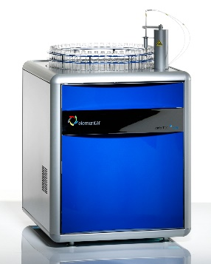

Hot Topics: Soil Extracts
Dedicated TOC analyzers
Freeze Drying
IR Detector for LOD in low ppm
SALTTRAP to prevent salts from damaging the instrument
Horizontal sample loop for prevention of clogging
Robust Teflon multi-way
valve has a long lifetime
Packing as a solid
Eliminates need for large volume liquid
Elementar is partners with Martin Christ Freeze Dryers

Slide 11
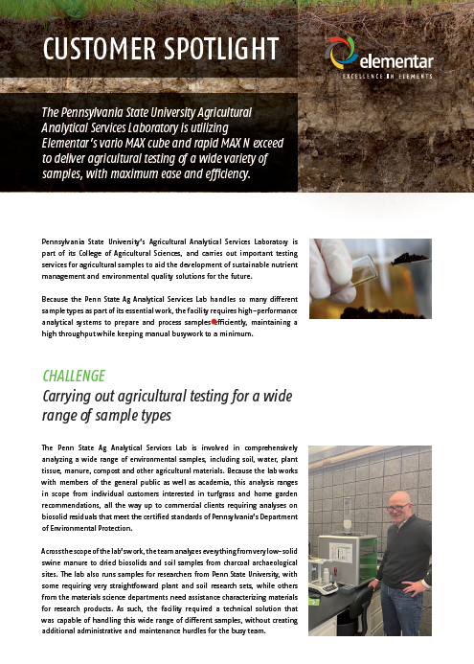
Long Partnerships: Penn State Ag Lab
John Spargo and Rachel Brimmer have been using our rapid MAX N exceed and vario MAX cube since 2014, and legacy instruments since early 2000s

Slide 12
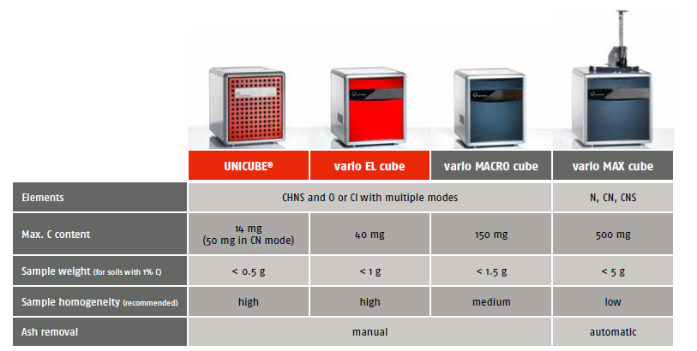
The vario Series

Slide 13
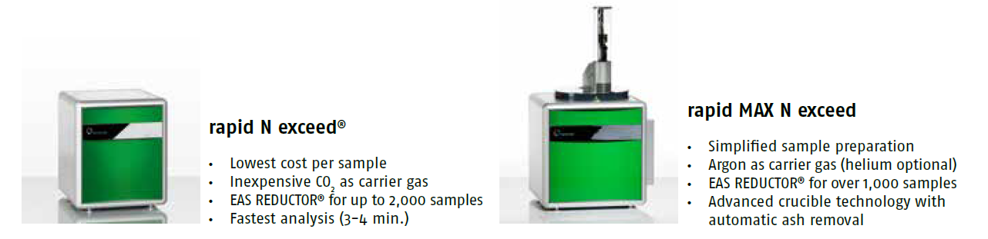
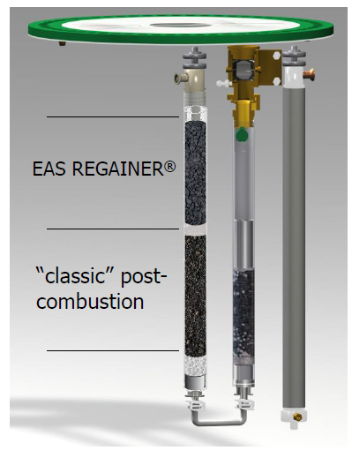
The exceed Series
EAS REGAINER®:metal free oxygen binding
•Post-combustion tube is partly filled with EAS REGAINER®which reacts with excess oxygen and releases reducing gases as by-product

Slide 14
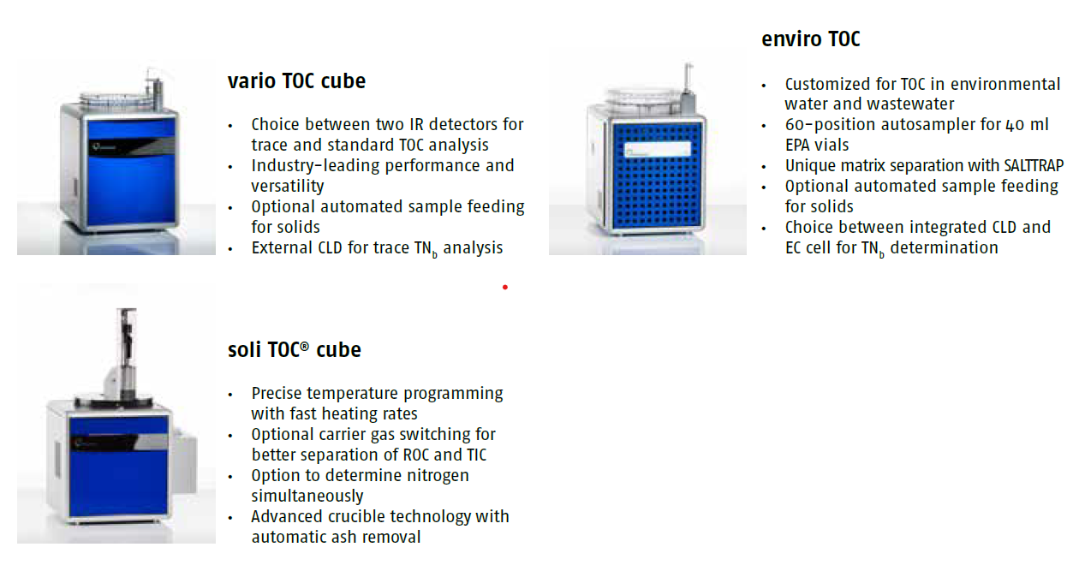
The TOC Series

Slide 15


www.elementar.de

Slide 16
Homogeneity and Sample Amount
Sample homogeneity
Sample amount
The larger the sample amount, the higher the homogeneity
→ i.e., the bigger the chance that the analyzed sample is representative for the entire substance

Slide 17
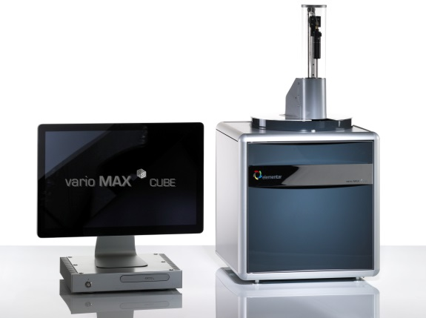
vario MAX cube – Solution for High Throughput
Addresses any high throughput laboratory
Designed for unattended, secure 24/7 operation
Up to 300 samples per day
Samples weighed into crucibles
Max 5g sample
90 position autosampler
Automatic ash removal with robotic arm
Available in CN and CNS Mode
Argon or Helium as carrier gas, easy switch

Slide 18

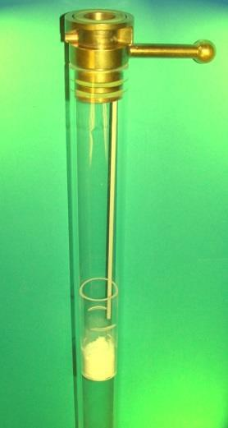
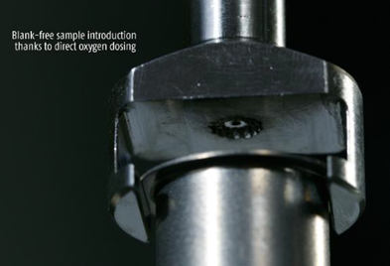
Sample Combustion
The furnace
The oxygen
The chemistry
Organic & inorganic compounds containing C,H,N,S
+ heat
+ oxygen
O₂ is directed at the spot of combustion.
Complete combustion is achieved with the smallest amount of O₂ per analysis.

Slide 19
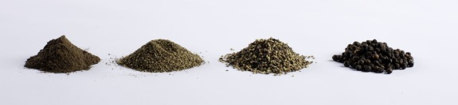
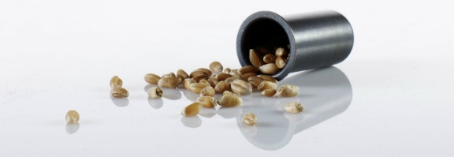
vario MAX cube – Simplified Sample Preparation
No grinding or milling
    Unique post-combustion technology ensures complete digestion of challenging species
    Always provides reliable data quality
Broad sample weight range
    Up to 5 g / 5 ml sample
    Up to 500 mg total carbon and 330 mg total nitrogen
Highest sample flexibility
    Inhomogeneous samples
    Samples with high ash content
Weigh in the crude samples into reusable crucibles
Place them on the autosampler
Start the sequence
Get the results!

Slide 20
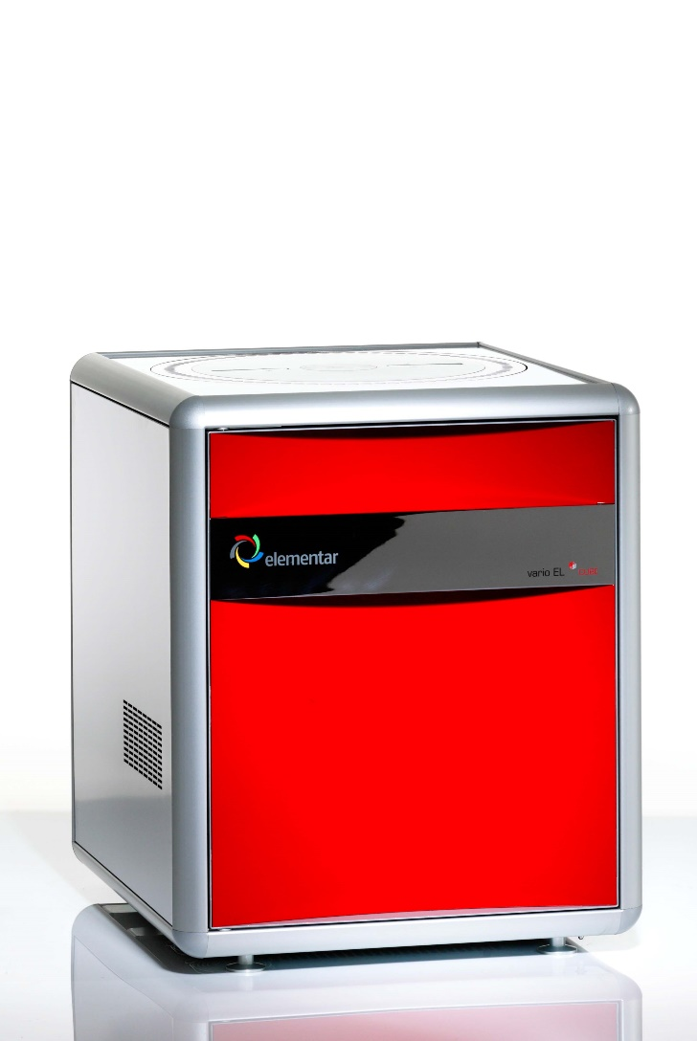
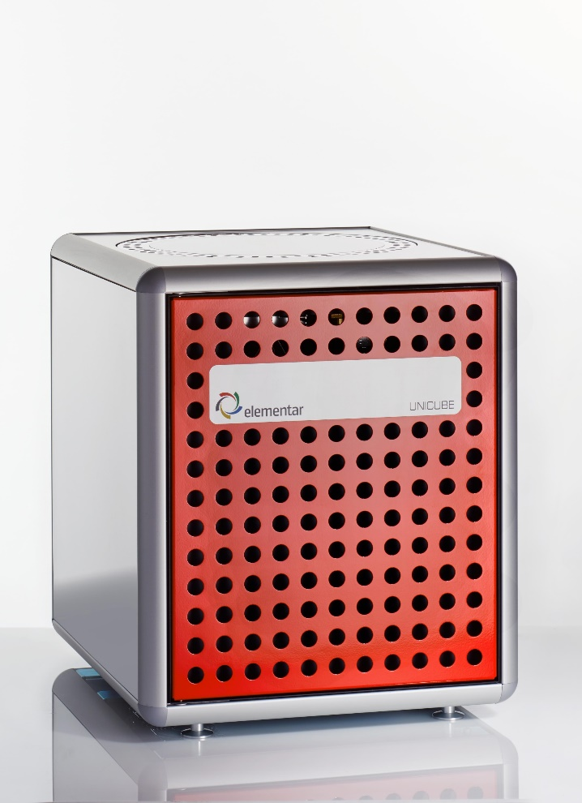
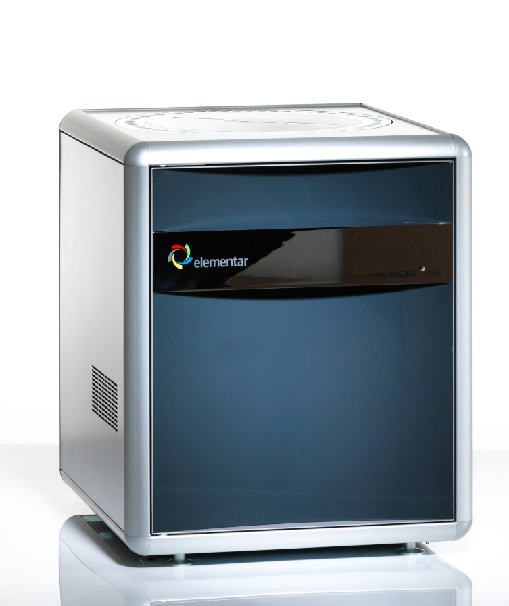
UNICUBE vario EL cube vario MACRO cube

Slide 21
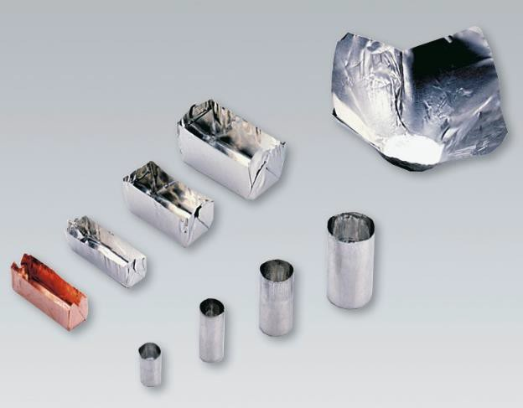
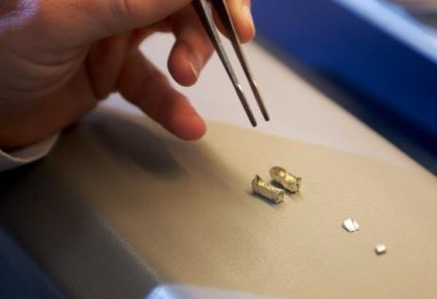

Sample preparation
Samples are wrapped in tin, silver, or aluminum containers (boats, foils, capsules).
Tin wrapping reacts exothermically during combustion.
» Locally increases combustion temperature to ~1800 ℃!

Slide 22
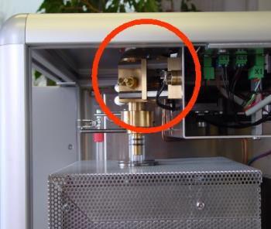
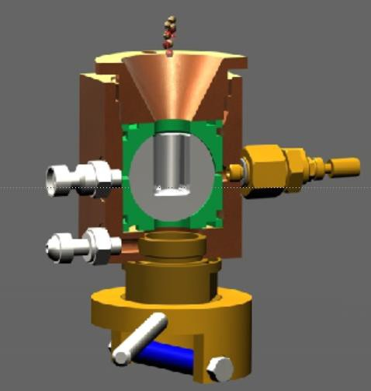
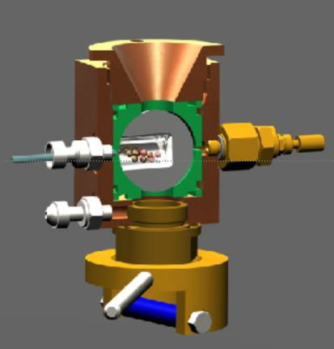
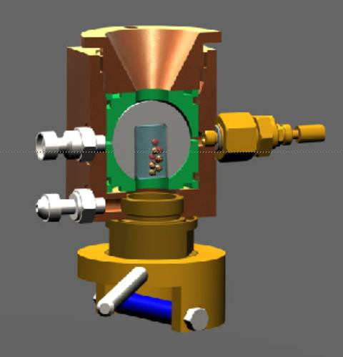
Blank-free Sample Introduction
Patented ball valve removes air out of the system
by flushing with carrier gas
» Blank-free sample introduction
Well-proven reliability & simple maintenance
1. Sample insertion
2. Flush with carrier gas
3. Sample transfer

Slide 23
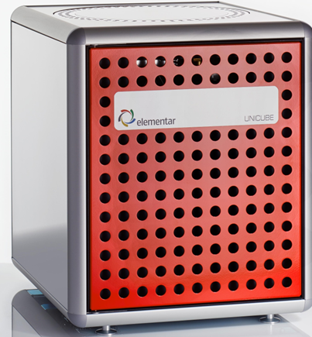

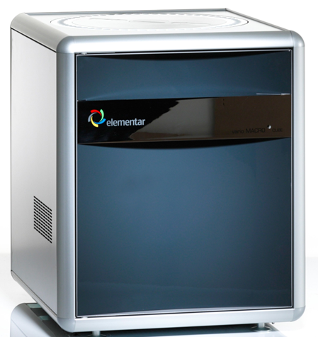
 | Unicube | Vario EL cube | Vario MACRO cube
Furnace Tubes | 2 (combustion, reduction) | 2 (combustion, reduction) | 3 (combustion, post-combustion, reduction)
Typical Balance | 6-place | 6-place, 5-place | 5-place, 4-place
Separation Column | 1 (Temperature Programmed Desorption) | 3 (CO₂, H₂O, SO₂) | 3 (CO₂, H₂O, SO₂)
Carbon Capacity | 50mg (CN Mode) | 40mg | 150mg
Carrier Gas | Helium or Argon, same TCD | Helium or Argon, TCD exchange | Helium only

Slide 24
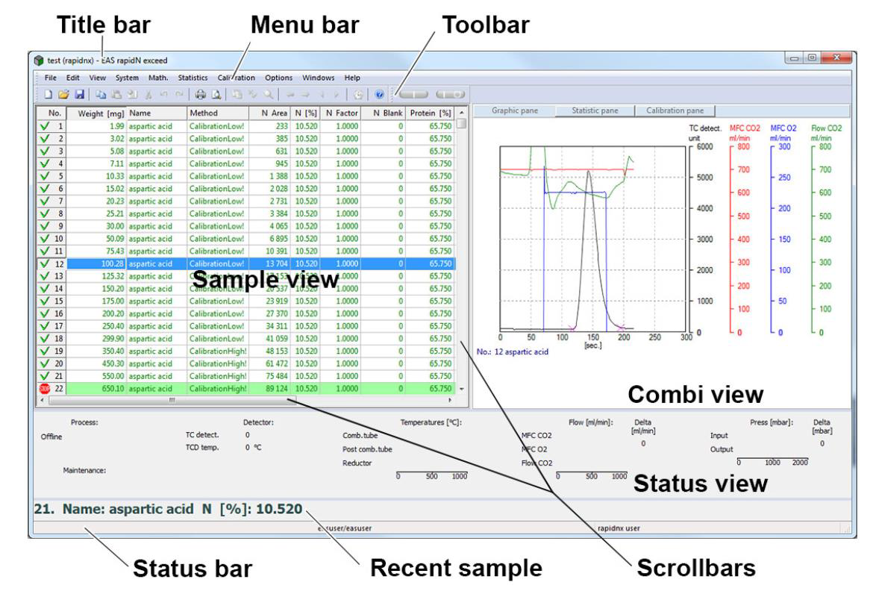
Software Overview

Slide 25
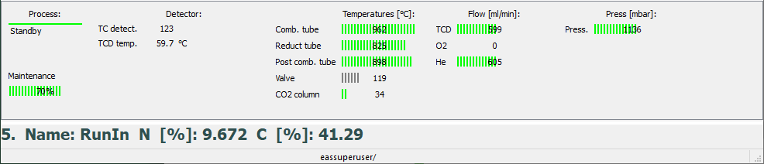
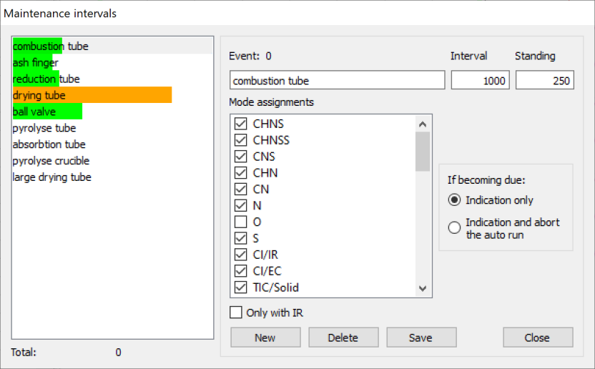
Daily Maintenance
Pressures and Flows
Maintenance Display
Preset intervals
Adjustment according to own experiences and kind and amount of sample
After maintenance, reset intervals
Addition of own events possible

Slide 26
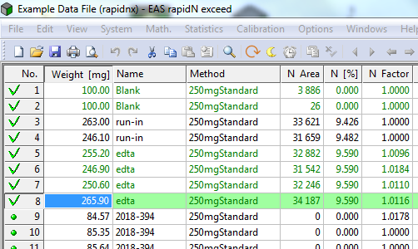
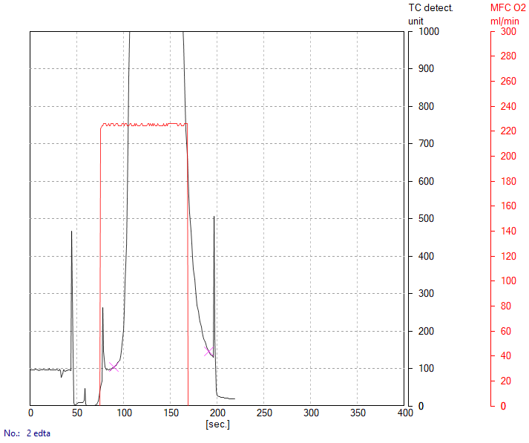
Daily Routine
Check if instrument is ready
  Oven temperature(s)
  Flows and pressures
  Maintenance display
  Standby mode
At least 2 blank measurements
  Areas for C and N <100 after
  2. measurement
At least 2 RunIn measurements
  Oxygen flow
  Standard deviation and reproducibility of results for standard sample
26

Slide 27
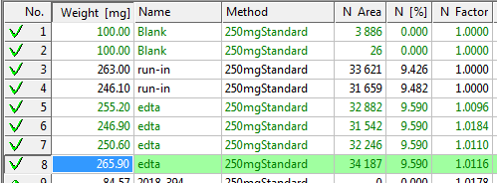
Daily Routine
Instrument readiness
At least 2 blank measurements
At least 2 RunIn measurements
Measurement for daily factor
Familiar sounds of instrument
  Instrument ready for sample sequence
Instrument readiness
At least 2 blank measurements
At least 2 RunIn measurements
Measurement of at least 3 standard samples
for determination of daily factor
  Daily factor between 0.900 and 1.100
  Difference between two values <0.010
Familiar sounds of instrument

